Slide 1




eSports
TOP EARNING TEAMS AND PLAYERS
SUBMITTED BY, PRAJITH.M

Slide 2











E-sports has rapidly grown into a global phenomenon, combining competitive gaming with entertainment and technology. Players and teams from around the world compete in tournaments, earning substantial prize money and recognition. This analysis focuses on the financial achievements of top players and teams, highlighting their contributions to the industry. Key insights include earnings trends across popular games such as "Counter-Strike" and "Overwatch." Additionally, the data explores genre popularity and regional representation among top performers. By examining player and team earnings, we gain a deeper understanding of the thriving e-sports ecosystem. This presentation provides an overview of the industry's competitive and financial dynamics.
Introduction

Slide 3
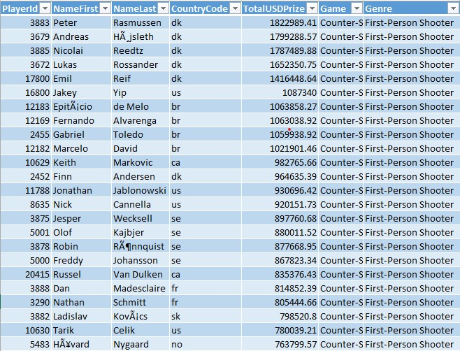
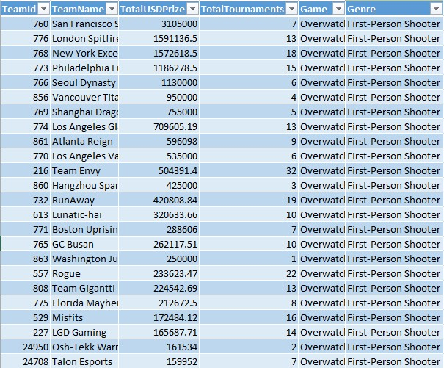
DATASET
Earning Players
Earning Teams

Slide 4
KEY DETAILS
Earning Teams
Unique Teams: 505
Unique Games Represented: 10
Top Games by Team Count:
Overwatch: 100 teams
Starcraft II: 100 teams
League of Legends: 100 teams
Highest Prize Earned by a Team: $33,810,636.13
Most Represented Game Genre:
1.Multiplayer Online Battle Arena (MOBA)
TeamId: A unique identifier for each team.
TeamName: The name of the team.
TotalUSDPrize: The total prize money the team has earned in USD across all tournaments.
TotalTournaments: The total number of tournaments in which the team has participated.
Game: The specific game in which the team competes (e.g., Overwatch, Starcraft II).
Genre: The genre of the game (e.g., Multiplayer Online Battle Arena, Real-Time Strategy).

Slide 5
KEY DETAILS
Earning Player
Unique Players: 998
Unique Games Represented: 10
Top Countries by Player Count:
South Korea (KR): 251 players
China (CN): 168 players
United States (US): 114 players
Highest Prize Earned by a Player: $6,952,596.58
Most Represented Game Genre: Multiplayer Online Battle Arena (MOBA)
PlayerId: A unique identifier for each player.
NameFirst: The first name of the player.
NameLast: The last name of the player.
CountryCode: The country the player represents, typically a two-letter code (e.g., KR for South Korea, US for the United States).
TotalUSDPrize: The total prize money the player has earned in USD across all tournaments.
Game: The specific game in which the player competes (e.g., Dota 2, League of Legends).
Genre: The genre of the game (e.g., Multiplayer Online Battle Arena, First-Person Shooter).

Slide 6
CHART USED
PLAYER EARNING BY COUNTRY AREA CHART
GAME BY TEAM HORIZONTAL BAR
TOTAL TEAMS EARNING BY GAME LINE CHART
GAME BY COUNT EARNING DONUT CHART
GENRE BY TEAM EARNING LOLIPOP CHART
PLAYER DISTRIBUTION ACROSS GAMES CIRCLE VIEW CHART
GAME FILTER
TOTAL USD PRIZE FILTER

Slide 7
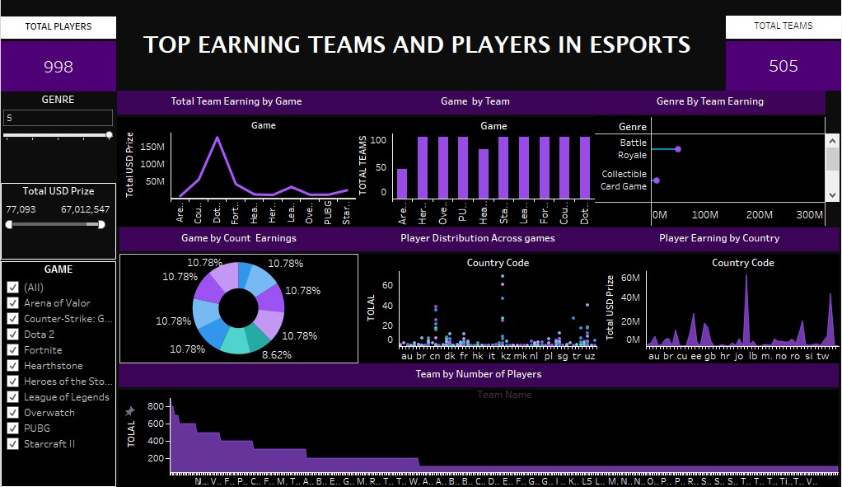
DASHBOARD

Slide 8
CONCLUSION
Top Countries & Games: South Korea, China, and the US dominate esports, with MOBA games like League of Legends and Dota 2 leading in earnings.
Player Earnings: The highest-earning player has won nearly $7 million, with 998 unique players competing in 10 games.
Team Earnings: The top team has earned over $33 million, with 505 unique teams participating in major games like Overwatch and Starcraft II.
Esports Growth: The large number of players, teams, and high prize pools highlight spurts as a thriving and lucrative global industry.

Slide 9
REFFERENCE
KAGGLE - DATASET

Slide 10

THANK YOU

